Slide 1

A Predictive Model for Heart Disease
SCTP Capstone Project 2
Lee Boon Chek 433A

Slide 2





Content
Business Understanding
Data understanding
Data Preparation
Modeling
FINAL Evaluation

Slide 3
BUSINESS UNDERSTANDING
Mass Marketing
Could be a waste of resources and not cost efficient.
Targeted Marketing
Identify the customer segment that has high risk of heart disease
Provide the targeted solutions and differentiated services
Customer centric, more efficient in terms of cost and resources
Using our prediction model, the marketing team can filter out customers who are likely in need of our heart disease solutions and services.

Slide 4
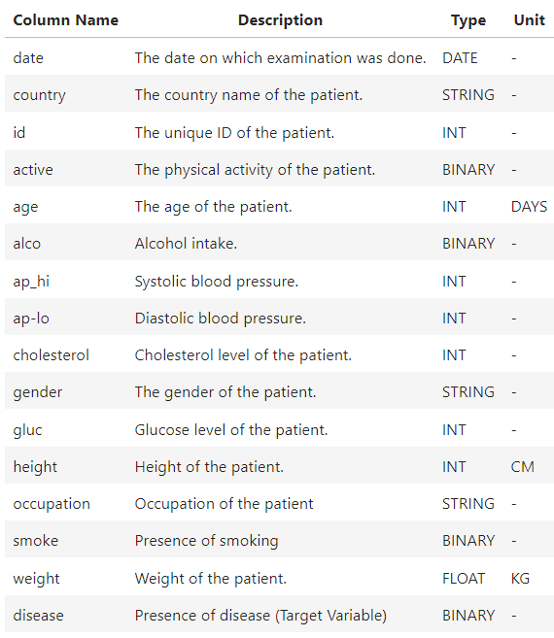
DATA UNDERSTANDING
Dataset from Parkway Pantai
1 csv file
70,000 rows and 16 columns
Target Variable is “disease”
7 continuous variables
8 categorical variables

Slide 5
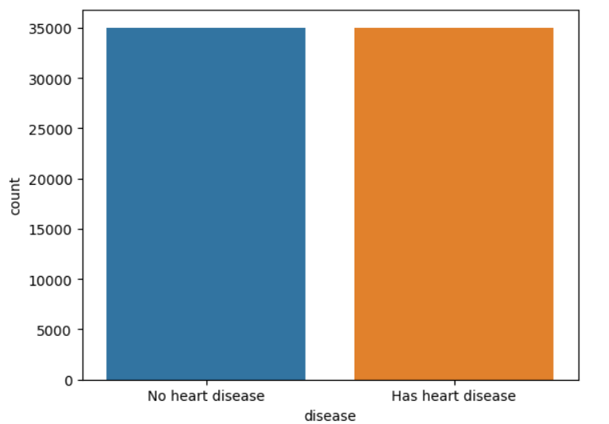
Distribution of ‘disease’ target variable
Number of records have no heart disease: 35021
Number of records have heart disease: 34979
Almost 50% of the records has heart disease.
Does not reflect the real world heart disease population, which is 5-10%.
Data might have been adjusted.

Slide 6
DATA PREPARATION
Preparation Steps
Check data type | All data types for each column are correct except ‘date’
Check missing data | No missing data for all columns
Check unit of each data type | Changed unit for ‘age’ from ‘day’ to ‘year’
Check any data entry error for object datatype | No spelling error or wrong input found for ‘country’ and ‘occupation’
Check outliers for integer and float datatype | Found few issues, further preprocessing is required.
Drop columns that are not related to target variable | Dropped ‘date’ , ‘id’ and ‘age (days)’ columns

Slide 7
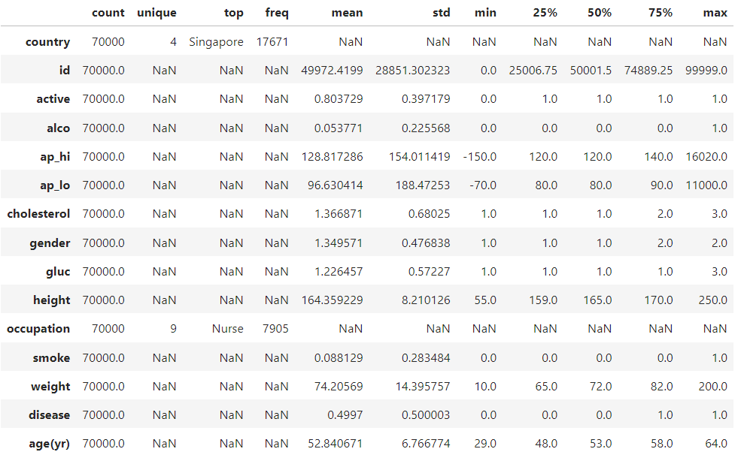
Outliers
Blood Pressure
Negative values
Values far away from median

Slide 8
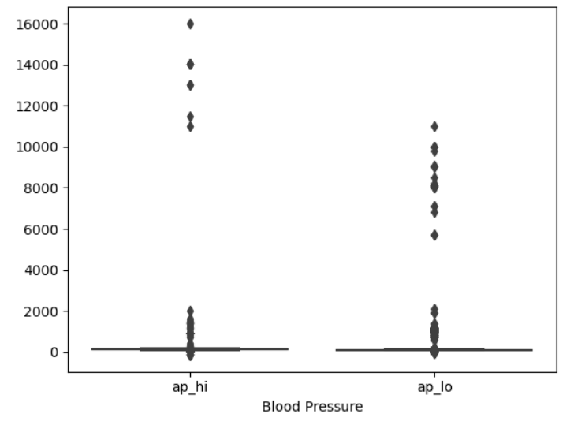
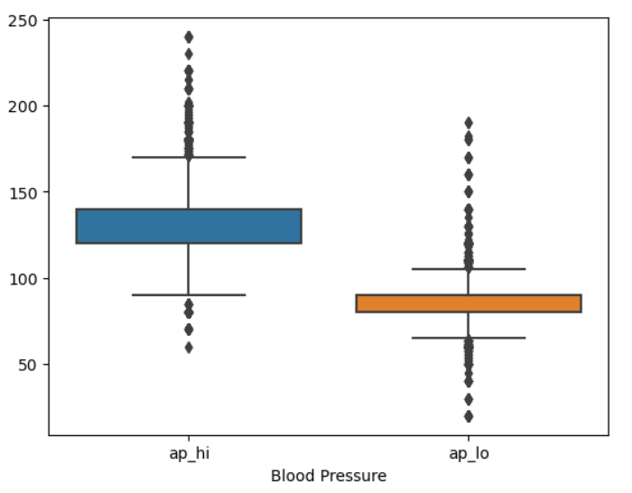
Outliers
Removed blood pressure values > highest recorded blood pressure
Removed blood pressure values < lowest recorded blood pressure

Slide 9
Outliers
Extreme values
Illogical value

Slide 10
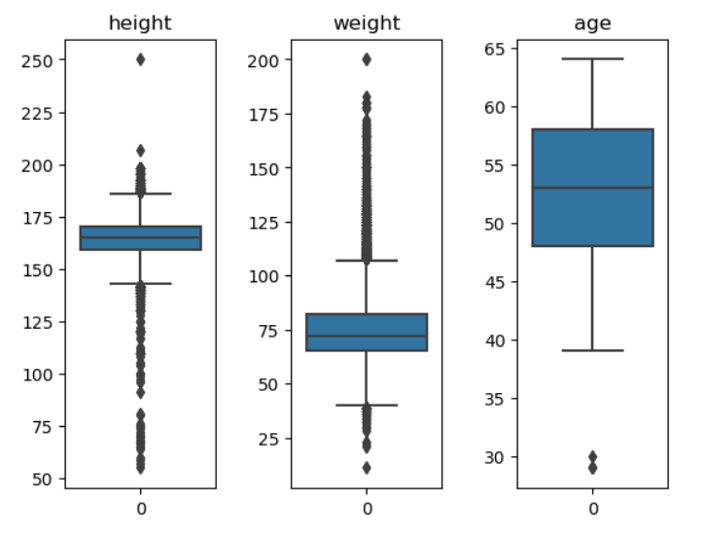
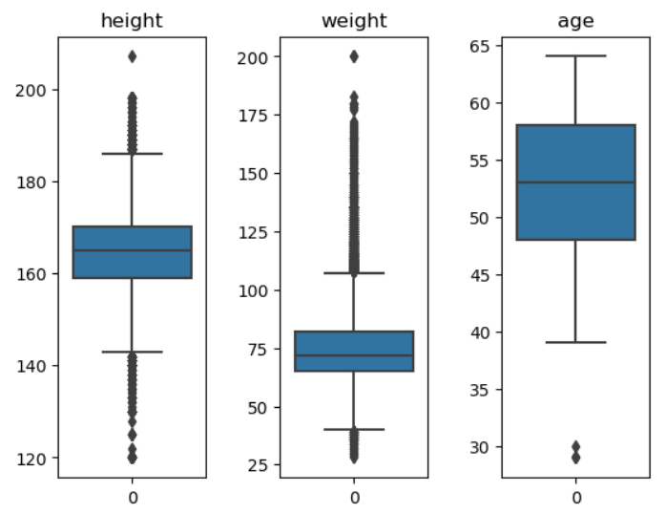
Outliers
Removed height > 220cm and height < 120cm
Removed weight < 25kg

Slide 11
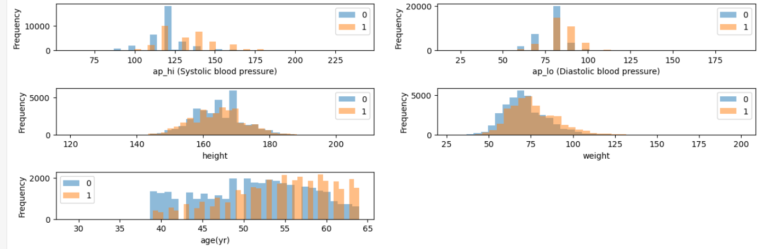
Finding Relation – Numerical Data
Ratio of ‘disease’ to ‘no disease’ increases when the value of the feature increases
No trend observed

Slide 12
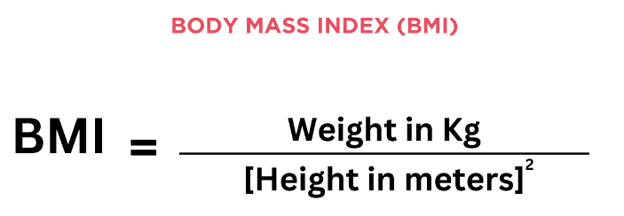
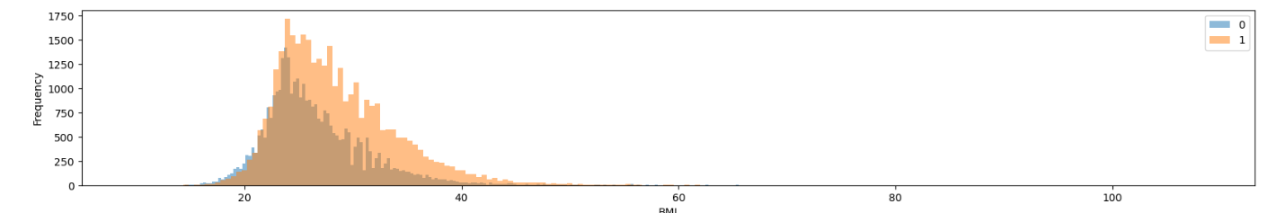
Feature Engineering
To account for height, weight and height are calculated into BMI, which shows number of disease increases when BMI increases.

Slide 13
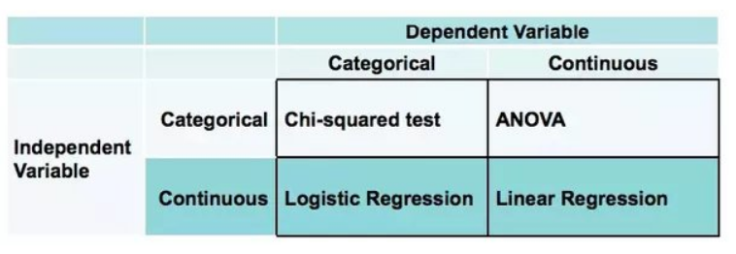
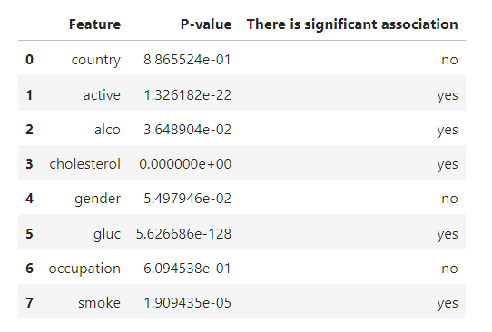
Finding Relation – Categorical Data
To check if each categorical feature is related to the categorical target variable (at significance level of 0.05)
p-value is higher than 0.05, hence there is no statistically significant association to the target variable
Drop ‘country’, ‘gender’, ‘occupation’ columns

Slide 14
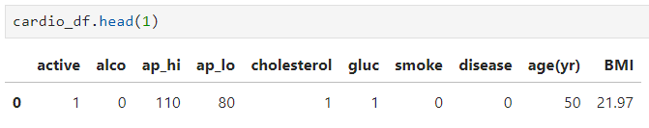
DATA PREPARATION
Dataset after cleaning
and preprocessing
68741 Rows, 10 Columns
Removed 1259 Rows, 6 Columns

Slide 15
Modeling – Baseline Model
Split Data
Assign ‘y’ as target variable.
Build Baseline Model
Build a simple Logistic Regression model with default parameters.
Evaluate Model Performance
Use cross-validation technique for evaluation instead of test set.
Assign ‘x’ as features.
Split dataset into 70% training, 30% testing.
Scale data into the range of 0 to 1.
Fit training data to the model.
To prevent the risk of overfitting on the test set.
Accuracy: 72.9%
Time taken: 0.2s

Slide 16
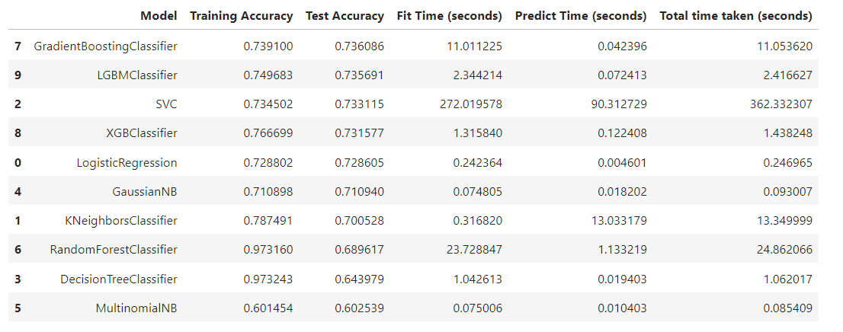
Modeling – Other Models
Not much test accuracy difference between different Gradient Boosting models
Test accuracy above 73%
Large difference between training and test accuracy: Overfitting
SVC: Took longest time

Slide 17
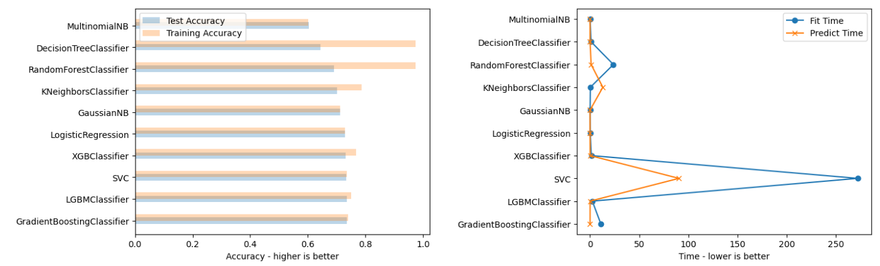
Decision Tree, Random Forest: Overfitting
Gradient Boosting: Highest test accuracy
SVC: High computation cost

Slide 18
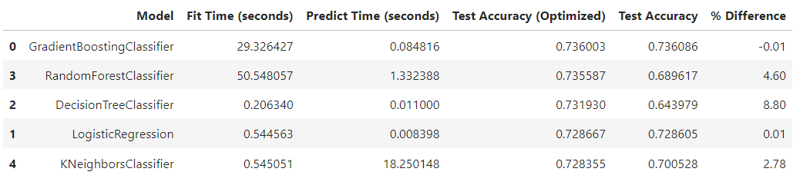
Modeling – Hyperparameters Optimization
Test accuracy after hyperparameters optimization
Gradient Boosting, Random Forest: High computation cost
Decision Tree: Largest improvement after optimization

Slide 19
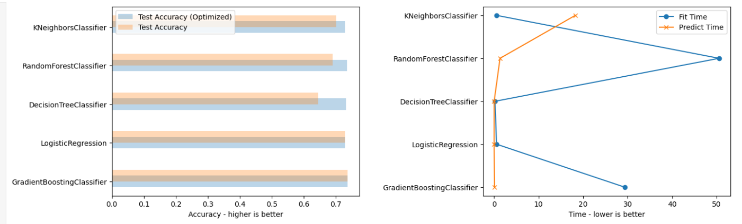
Modeling – Hyperparameters Optimization
Lowest computation cost
Choose Simplest Model!
Insignificant difference (less than 1%) of optimized test accuracy between the five models

Slide 20
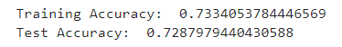
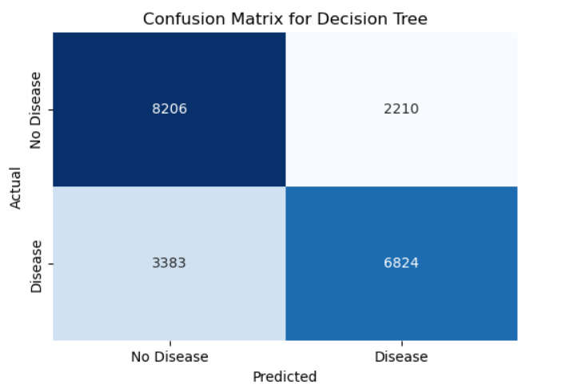
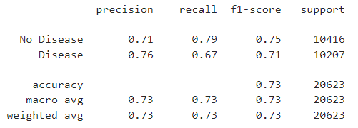
Final selected model: Decision Tree
Final Evaluation
Optimized hyperparameters: max_depth: 5, max_leaf_nodes: 20
Test accuracy: 72.9% using test data
Out of the cases predicted with Heart Disease, 76% are actually diagnosed with Heart Disease. Out of the cases predicted with no Heart Disease, 71% are actually diagnosed with no Heart Disease.
From all cases with Heart Disease, 67% are predicted correctly. From all cases with no Heart Disease, 79% are predicted correctly.

Slide 21
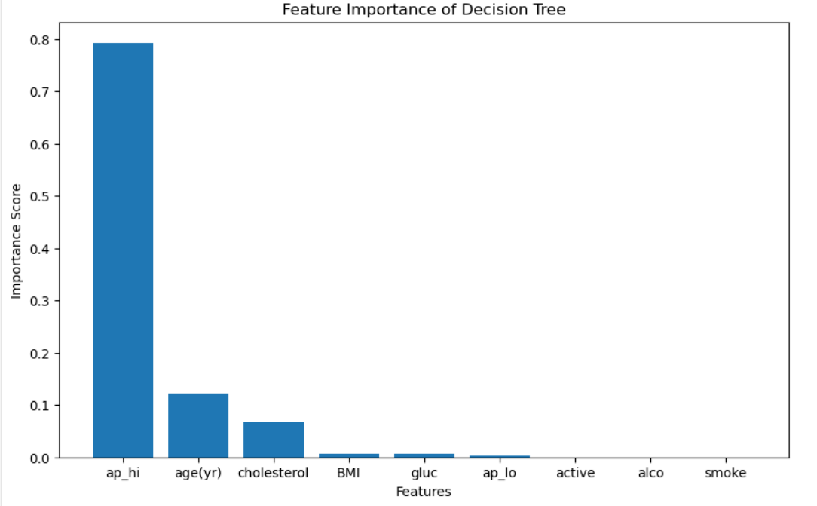
Final Evaluation
The top three most important features in predicting Heart Disease are
systolic blood pressure (the pressure in your arteries when your heart beats or contracts to pump blood out into the body),
age, and
cholesterol level.

Slide 22
Final Evaluation – Conclusion and Recommendation
Overall the final model test score is not sufficiently high. Almost one out of four predictions is wrong.
Reasons:
Some numerical features such as cholesterol level and glucose level are given as categories, causing loss of details in data.
Data may have been manipulated so that number of disease is almost same as number of no disease.
Recommendations for improvement:
To look for original data that has not been adjusted and features like cholesterol level and glucose level are in numerical form.
Include other heart disease relevant features such as ‘Presence of Diabetes’ and ‘Family History’.

Slide 23

THANK YOU
https://github.com/87Iodo/SCTP_Capstone.git
Appendix:

